Slide 1


Bhavya S Devarakonda
10/04/2022

Slide 2

Outline
Executive Summary
Introduction
Methodology
Results
Conclusion
Appendix

Slide 3
Executive Summary
Space X advertises Falcon 9 rocket launches on its website, with a cost of 62 million dollars; while other providers cost upward of 165 million dollars. Space X cost is relatively less as it reuses the first stage. Our aim in this project is to predict the first stage launch outcome, that helps determine the cost of a launch.
In order to perform the research analysis, we have followed all the standard Data Science methodologies. The business purpose is to determine if an alternate company wants to bid against SpaceX for a rocket launch. Raw Data was collected from the Space X API and Wikipedia using Web Scraping technique (BeautifulSoup package) and further performed Wrangling and EDA using SQL. Performed Predictive Analysis to build and determine the model accuracy and prediction.
In conclusion, we have observed that the landing success rate got better over time and for certain payloads and Launch Sites, the successful landing outcome is more.

Slide 4
Introduction
Space X advertises Falcon 9 rocket launches on its website, with a cost of 62 million dollars; while other providers cost upward of165 million dollars. Space X cost is relatively less as it reuses the first stage. Our aim in this project is to predict the first stage launch outcome, that helps determine the cost of a launch.
We want to identify the if the first stage of the launch is successful and determine the cost based on this observation.

Slide 5

Section 1

Slide 6
Methodology
Executive Summary
Data collection methodology:
Used SpaceX API and BeautifulSoup Python package for webscrapping the data from Wikipedia.
Perform data wrangling
Identified several cases where the booster did not land successfully and converted those to 0-failure or 1-successful and added it as a column ‘Class’ to the launch DataFrame.
Perform exploratory data analysis (EDA) using visualization and SQL
Perform interactive visual analytics using Folium and Plotly Dash
Perform predictive analysis using classification models
Used Logistic Regression, Support Vector Machine, Decision Tree Classifier and K-Nearest Neighbor algorithms to perform the predictive analysis

Slide 7
Data Collection
Data Collection has been done using SpaceX API endpoints and also from Wikipedia by using Web Scrapping technique via the BeautifulSoup Python package.
Following templates explain in detail steps.

Slide 8
Data Collection – SpaceX API
GitHub: https://github.com/bhavyasd/IBM-DataScience-Certificate/blob/main/Applied%20Data%20Science%20Capstone/jupyter-labs-spacex-data-collection-api.ipynb
Imported libraries: requests, numpy, pandas, datetime
Defined Auxillary functions that will help us use the API to extract information using the Identification numbers in the launch data.
Request and parse the SpaceX launch data using the GET request
Normalized the JSON response, converted the response to a Dataframe and exported it to CSV.

Slide 9
Data Collection - Scraping
GitHub URL: https://github.com/bhavyasd/IBM-DataScience-Certificate/blob/main/Applied%20Data%20Science%20Capstone/jupyter-labs-webscraping.ipynb
Imported libraries: requests, numpy, pandas, datetime
Extract a Falcon 9 launch records HTML table from Wikipedia using requests.get() method
Created a BeautifulSoup Object from HTML response
Parse the table and convert it into a Pandas data frame
Exported the results to CSV.

Slide 10
Data Wrangling
Loaded the Data from CSV and performed Data Analysis.
Identified and calculated the percentage of missing values in each attribute.
Identify the columns that are numerical and categorial
Determined the number of Launch Sites as each launch aims to a dedicated orbit. Review GITURL for the orbit information
Used value_counts() method to determine the number of occurrence of each orbit, occurrence of landing outcome per orbit type
Created a landing outcome column based on the outcome of the landing, 0 if bad, 1 if landing is successful
Git Repo: https://github.com/bhavyasd/IBM-DataScience-Certificate/blob/main/Applied%20Data%20Science%20Capstone/labs-jupyter-spacex-Data%20wrangling.ipynb

Slide 11
EDA with Data Visualization
Charts plotted:
CatPlot
Scatter Plot
Bar Chart
These chart have been plotted to visualize and obtain insights from the data and to perform feature engineering
Applied on hot encoding to create dummy variables to the categorical columns
Git repo: https://github.com/bhavyasd/IBM-DataScience-Certificate/blob/main/Applied%20Data%20Science%20Capstone/jupyter-labs-eda-dataviz.ipynb

Slide 12
EDA with SQL
Performed the following SQL commands:
Display the names of the unique launch sites in the space mission
Display 5 records where launch sites begin with the string 'CCA'
Display the total payload mass carried by boosters launched by NASA (CRS)
Display average payload mass carried by booster version F9 v1.1
List the date when the first successful landing outcome in ground pad was achieved.
List the names of the boosters which have success in drone ship and have payload mass greater than 4000 but less than 6000
List the total number of successful and failure mission outcomes
List the names of the booster_versions which have carried the maximum payload mass. Use a subquery
List the records which will display the month names, failure landing outcomes in drone ship ,booster versions, launch_site for the months in year 2015.
Rank the count of successful landing_outcomes between the date 04-06-2010 and 20-03-2017 in descending order.
Git repo: https://github.com/bhavyasd/IBM-DataScience-Certificate/blob/main/Applied%20Data%20Science%20Capstone/jupyter-labs-eda-sql-coursera_sqllite.ipynb

Slide 13
Build an Interactive Map with Folium
Used circles and markers to each launch site and lines to determine proximity limits for each site from coast, railroad, highway and cities
We wanted to determine if launch success rate is depended on the location and the proximities of a launch site i.e., the initial position of the rocket trajectories. We’ve observed that all launch sites are closed to the coast.
Git repo: https://github.com/bhavyasd/IBM-DataScience-Certificate/blob/main/Applied%20Data%20Science%20Capstone/lab_jupyter_launch_site_location.ipynb

Slide 14
Build a Dashboard with Plotly Dash
Used dropdown for launch sites and slider for Payload Mass range
Used pie chart to display the success rate for all launch sites and also specific sites.
Plotted scatter plot using Payload range slider and site selected from the dropdown to visualize payload mass vs launch success.
Git repo: https://github.com/bhavyasd/IBM-DataScience-Certificate/blob/main/Applied%20Data%20Science%20Capstone/spacex_dash_app.py

Slide 15
Predictive Analysis (Classification)
Imported Libraries and Defined Auxillary functions, loaded dataframe, created a class column with 0s and 1s
Normalized the data for better analysis, split test and train data sets. The training data is divided into validation data, a second set used for training data; then the models are trained and hyperparameters are selected using the function GridSearchCV.
Performed Analysis using estimators, parameters for different models – we used Logistic Regression, Support Vector Machine, Decision Tree Classifier, K-Nearest Neighbors.
Plotted confusion matrix to compare the predicted vs actual values.
Git repo: https://github.com/bhavyasd/IBM-DataScience-Certificate/blob/main/Applied%20Data%20Science%20Capstone/SpaceX_Machine%20Learning%20Prediction_Part_5.ipynb

Slide 16
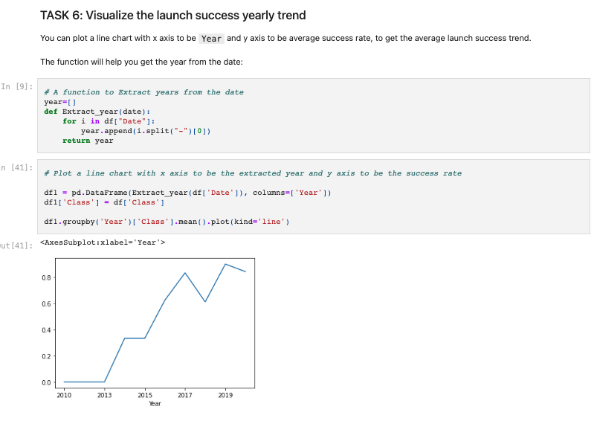
Exploratory Data Analysis Results
Observed that the success rate kept increasing from 2013 to 2020

Slide 17
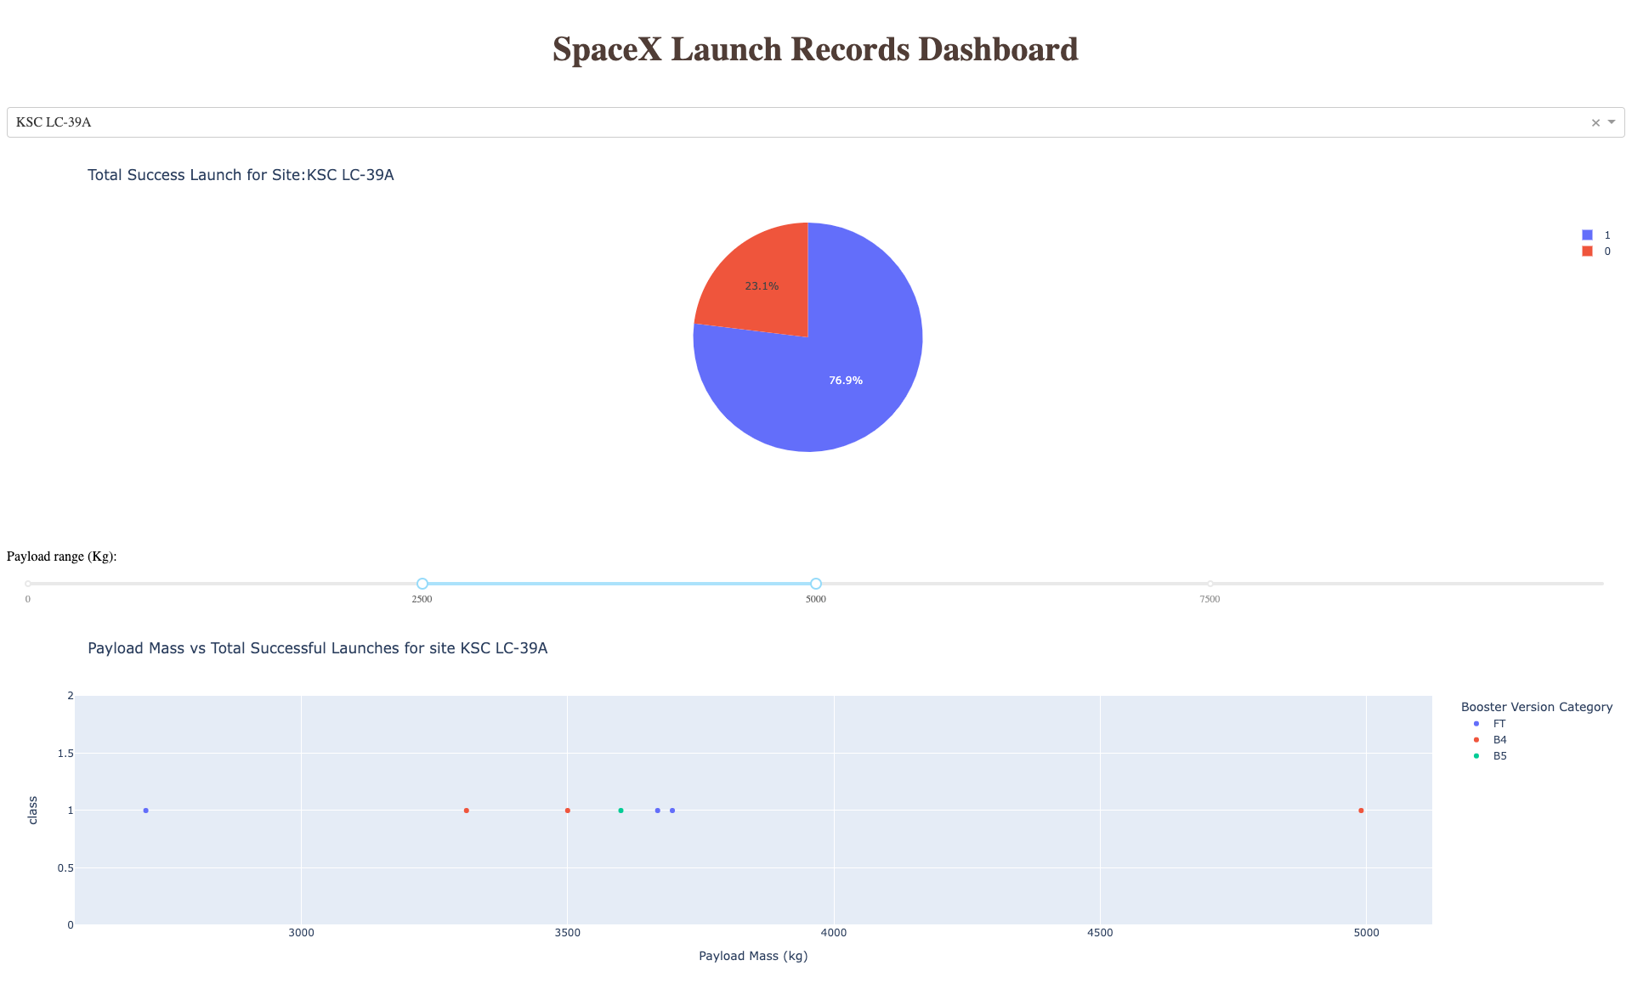
Interactive Analytics Results

Slide 18
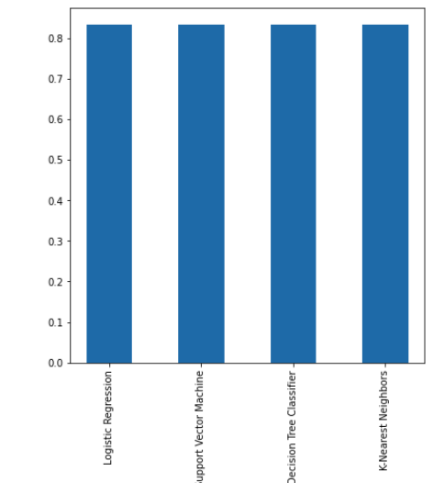
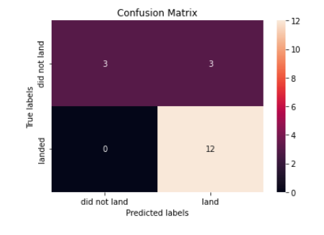
Predictive Analysis Results

Slide 19

Section 2

Slide 20
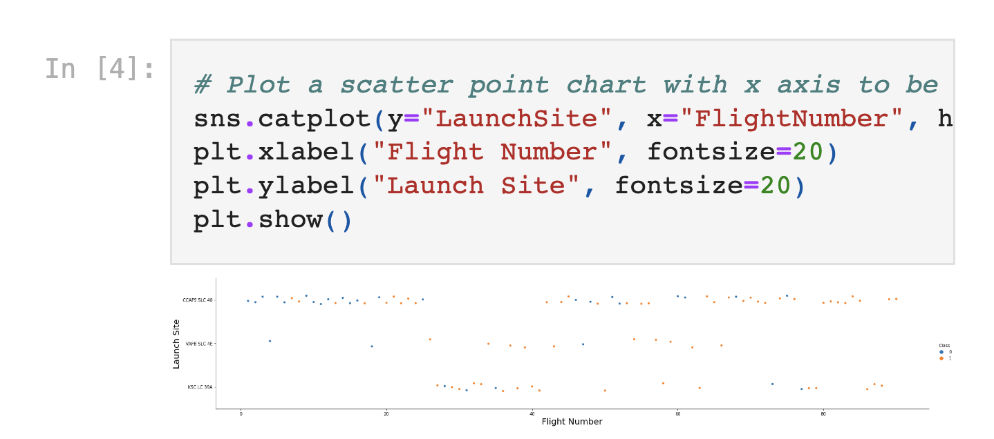
Flight Number vs. Launch Site
We can observe that the Launch Site CCAFS SLC-40 has more launches compared to other sites. We observe the launches to be more successful as the flight number increases.
Launch Site VAFB-SLC has relatively less failure compared to the other two

Slide 21
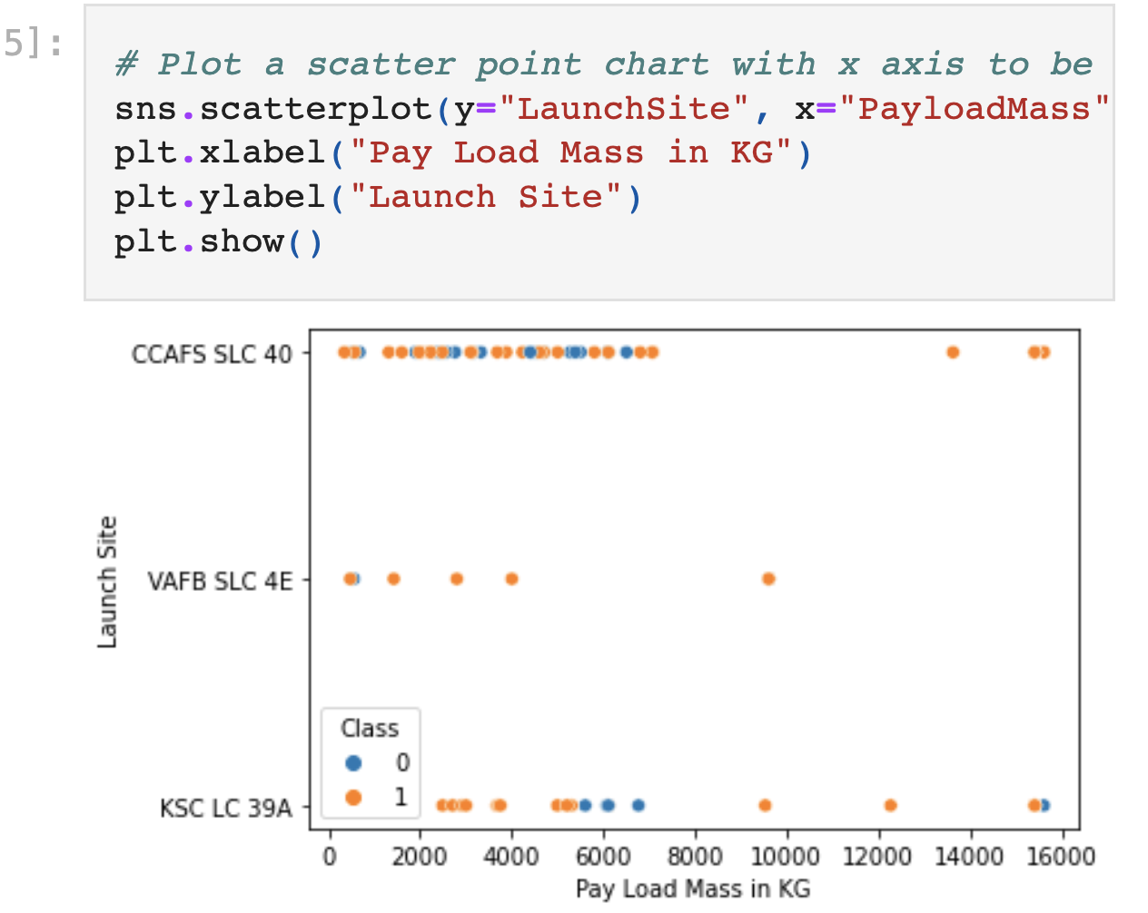
Payload vs. Launch Site
We can observe Payload Vs. Launch Site scatter point chart you will find for the VAFB-SLC launch site there are no rockets launched for heavypayload mass(greater than 10000).

Slide 22
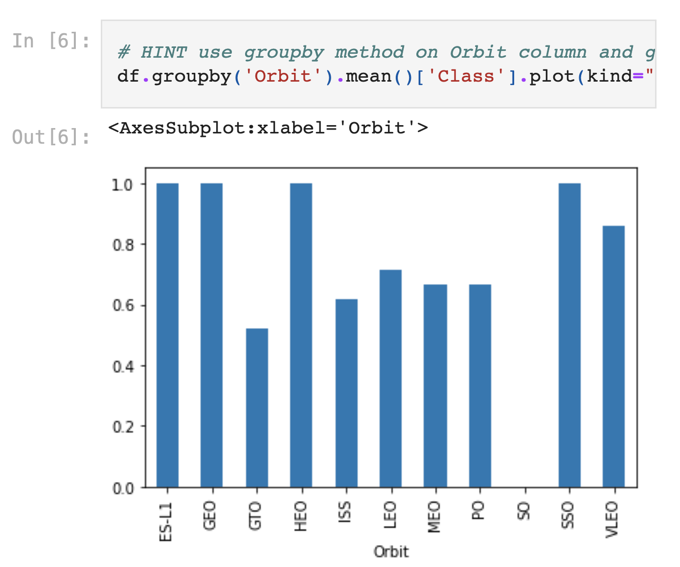
Success Rate vs. Orbit Type
From the bar chart we observe that the orbits ES-L1, GEO, HEO, SSO, VLEO have a highest success rate.

Slide 23
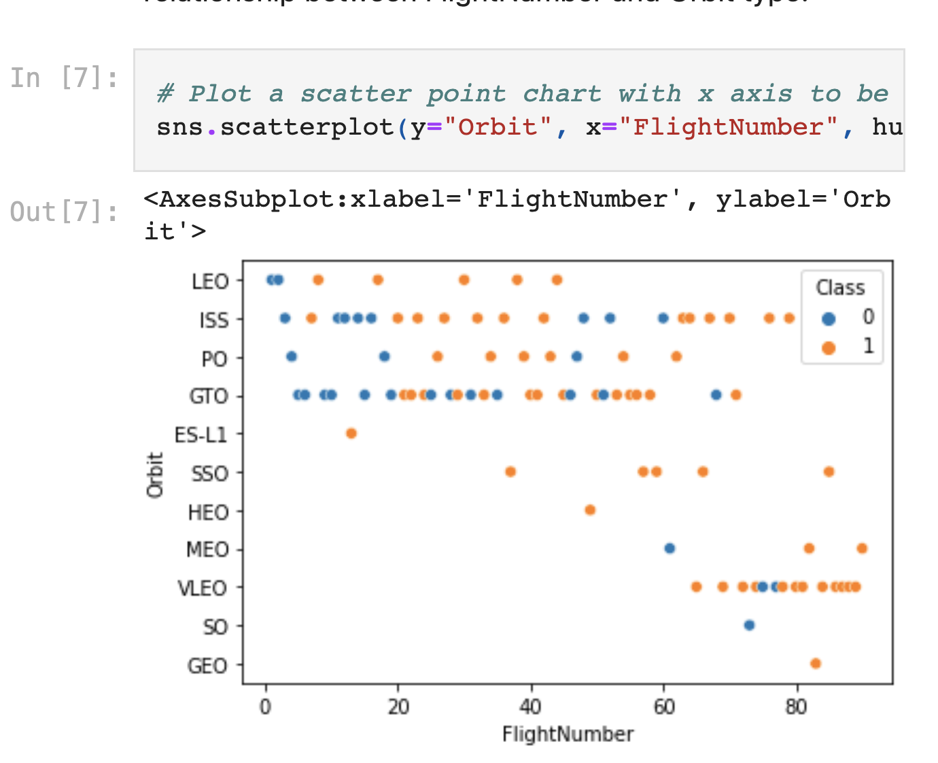
Flight Number vs. Orbit Type
We observe that in the LEO orbit the Success appears related to the number of flights; on the other hand, there seems to be no relationship between flight number when in GTO orbit

Slide 24
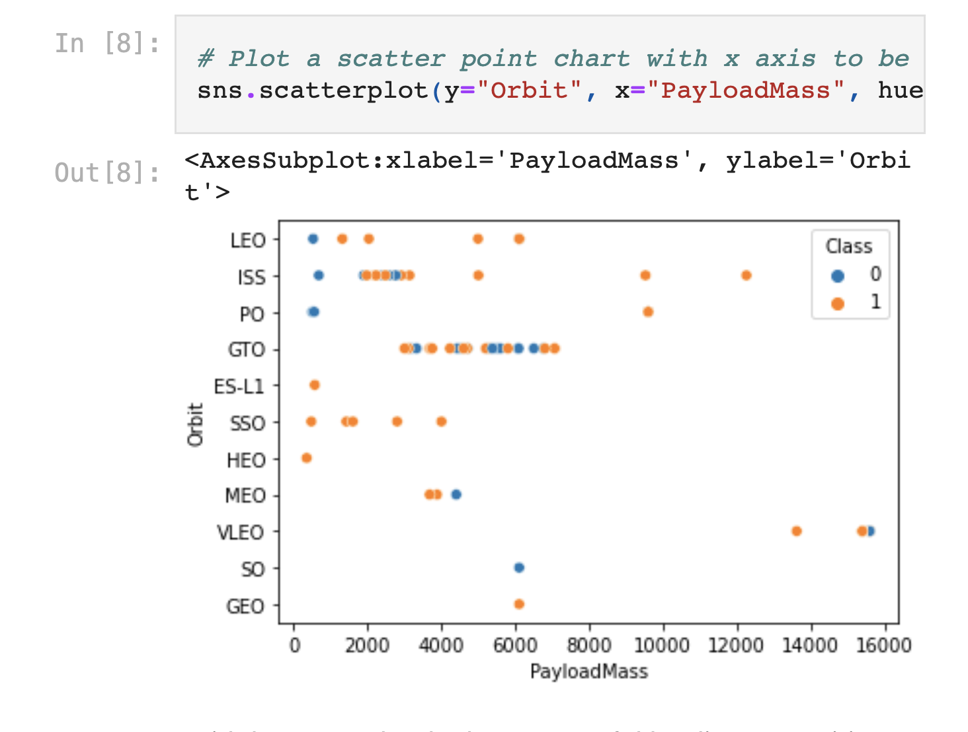
Payload vs. Orbit Type
We observe that with heavy payloads the successful landing or positive landing rate is more for Polar, LEO and ISS.
However, for GTO we cannot distinguish this well as both positive landing rate and negative landing(unsuccessful mission) are both there here

Slide 25
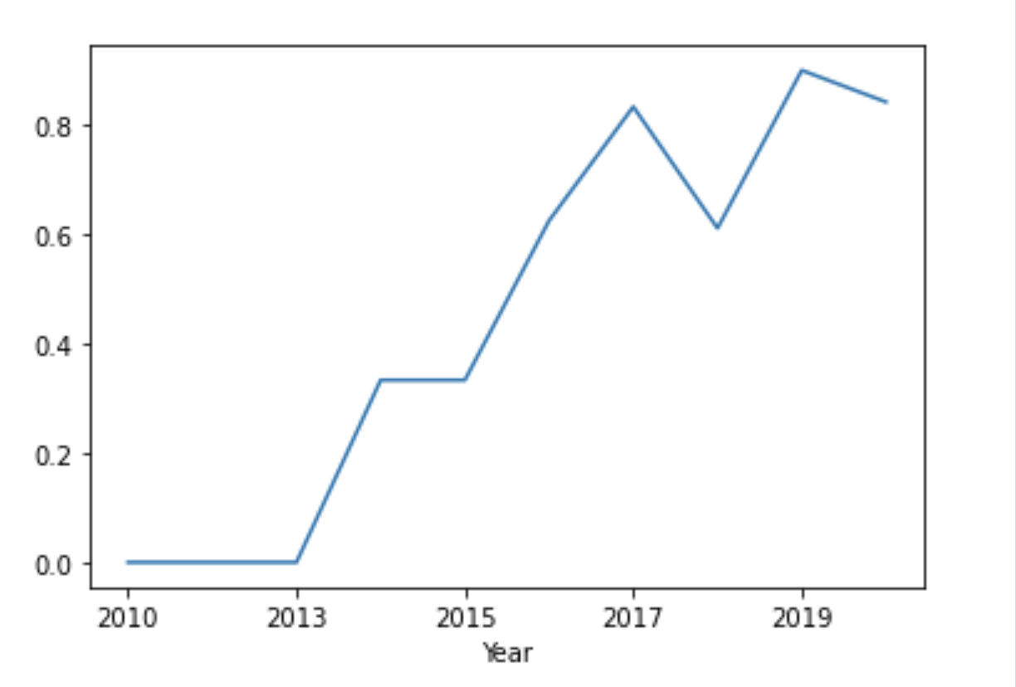
Launch Success Yearly Trend
We see that the launch success kept increasing since year 2013, with a dip in year 2018.

Slide 26
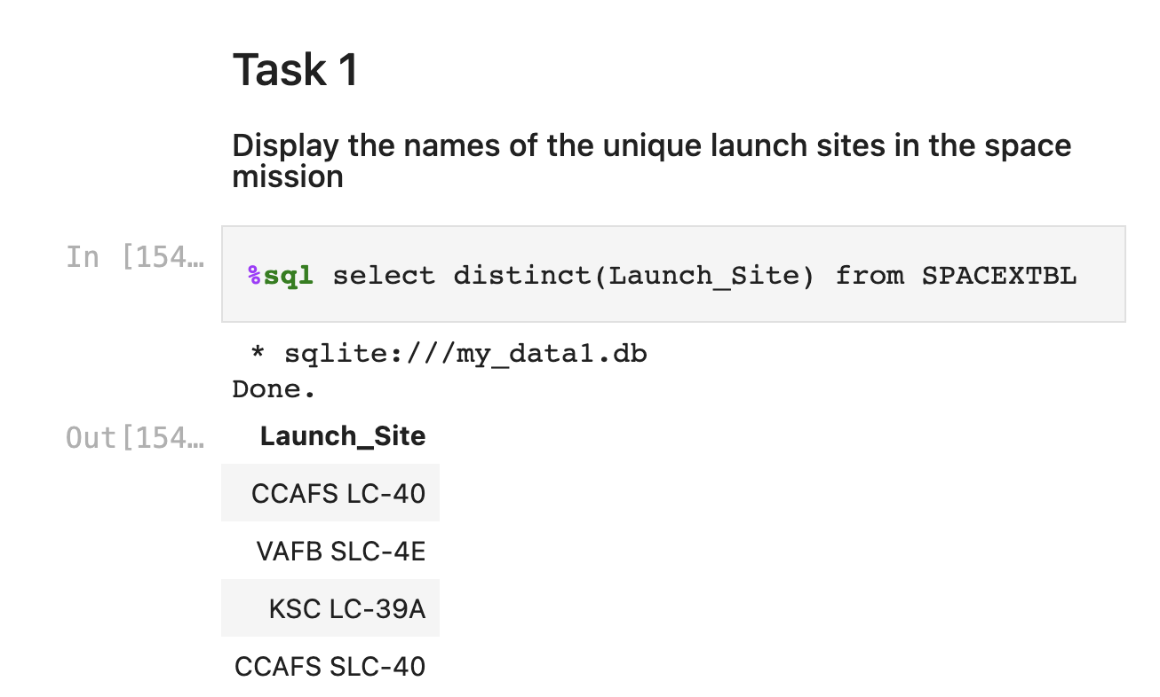
All Launch Site Names
Find the names of the unique launch sites
Present your query result with a short explanation here

Slide 27
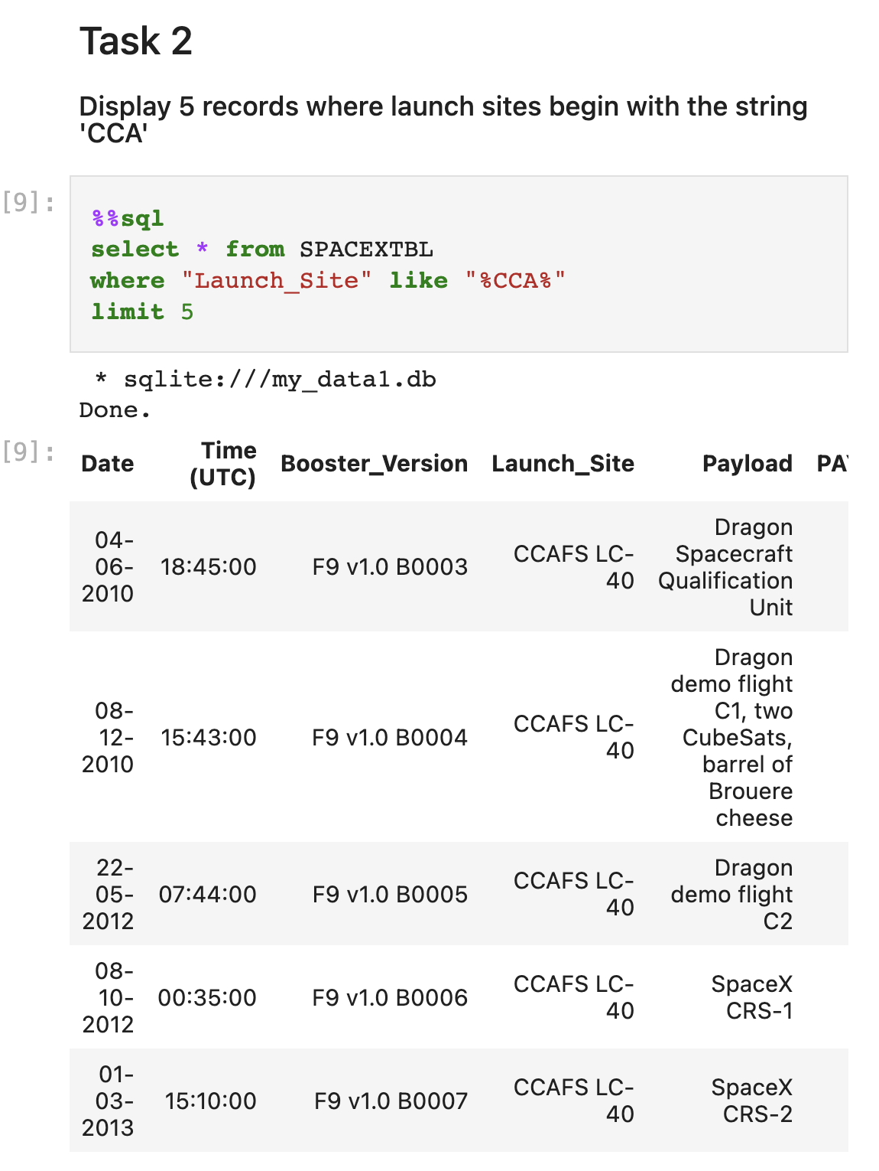
Launch Site Names Begin with 'CCA'
Find 5 records where launch sites begin with `CCA`
Present your query result with a short explanation here

Slide 28
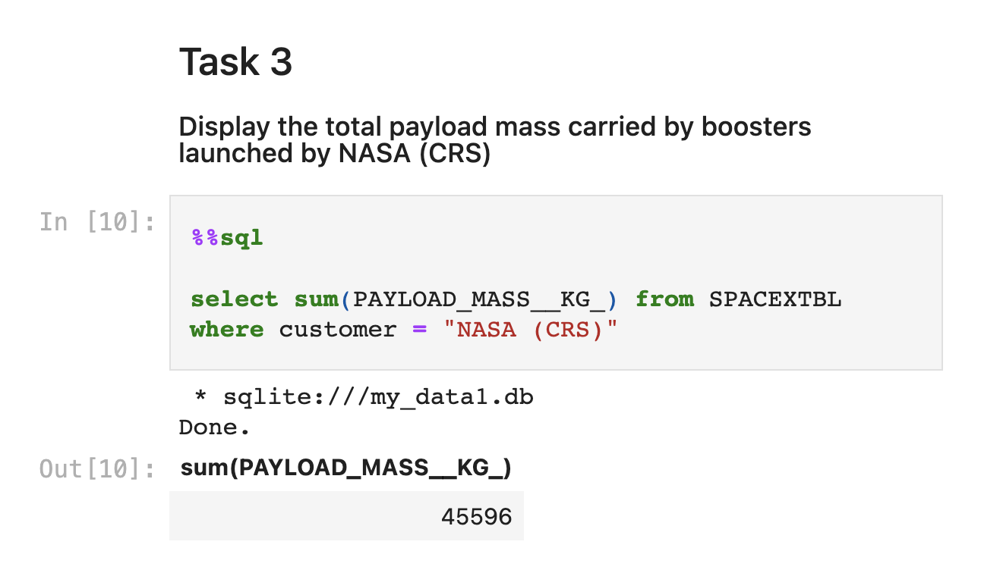
Total Payload Mass
Calculate the total payload carried by boosters from NASA
Present your query result with a short explanation here

Slide 29
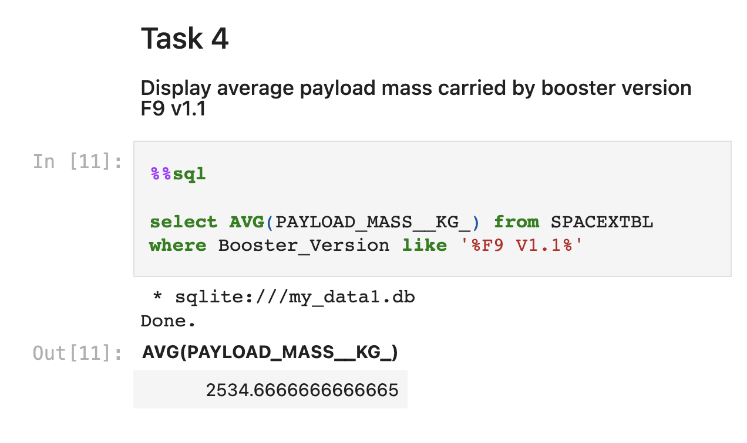
Average Payload Mass by F9 v1.1
Calculate the average payload mass carried by booster version F9 v1.1
Present your query result with a short explanation here

Slide 30
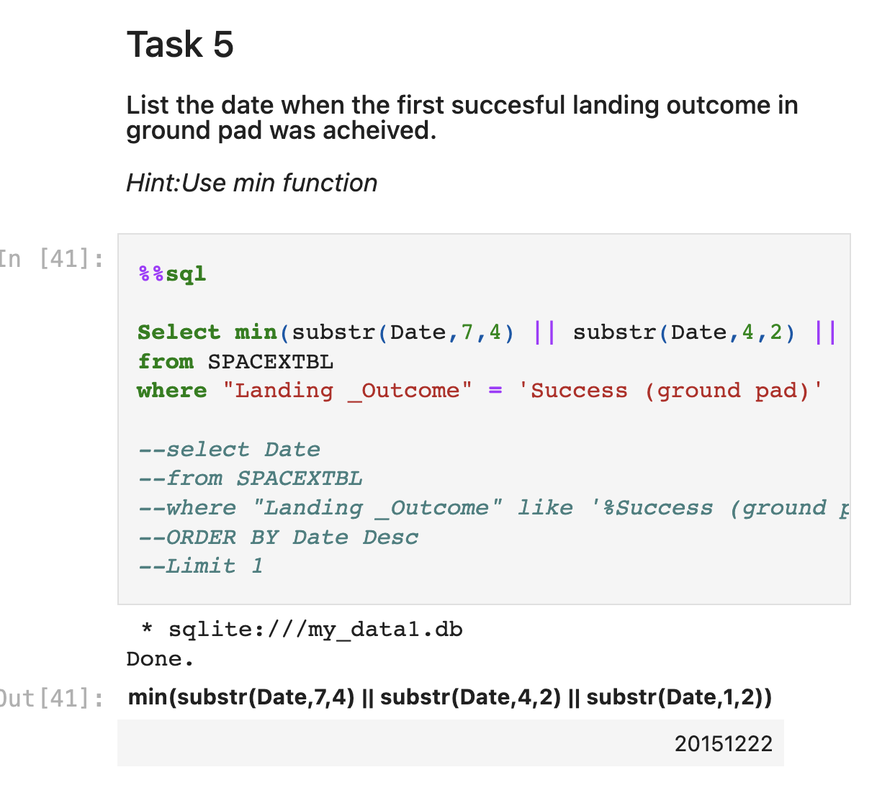
First Successful Ground Landing Date
Find the dates of the first successful landing outcome on ground pad
Present your query result with a short explanation here

Slide 31
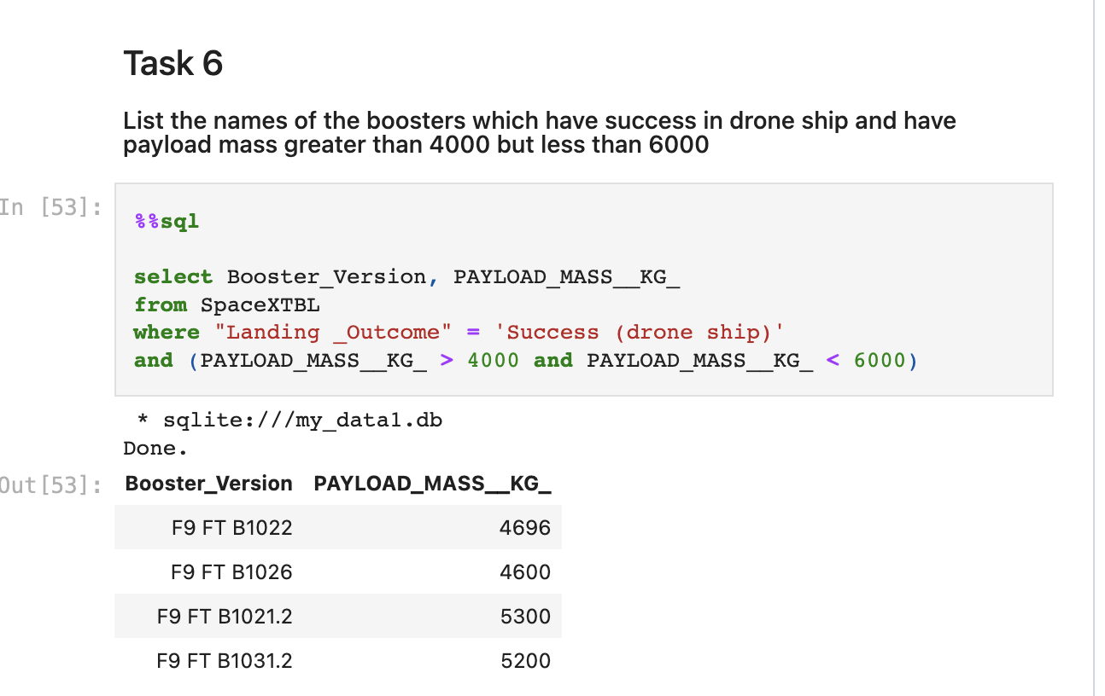
Successful Drone Ship Landing with Payload between 4000 and 6000
List the names of boosters which have successfully landed on drone ship and had payload mass greater than 4000 but less than 6000
Present your query result with a short explanation here

Slide 32
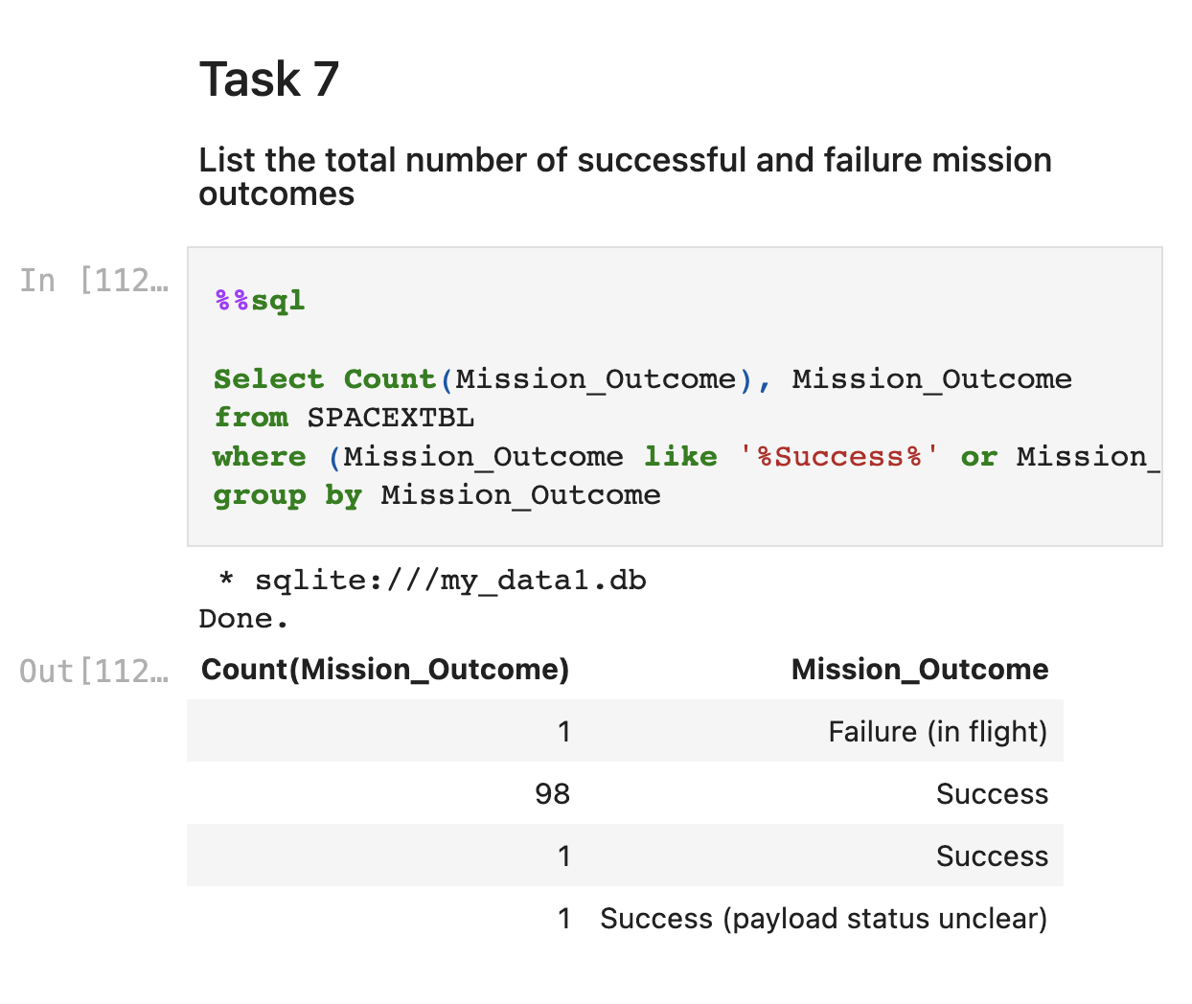
Total Number of Successful and Failure Mission Outcomes
Calculate the total number of successful and failure mission outcomes
Present your query result with a short explanation here

Slide 33
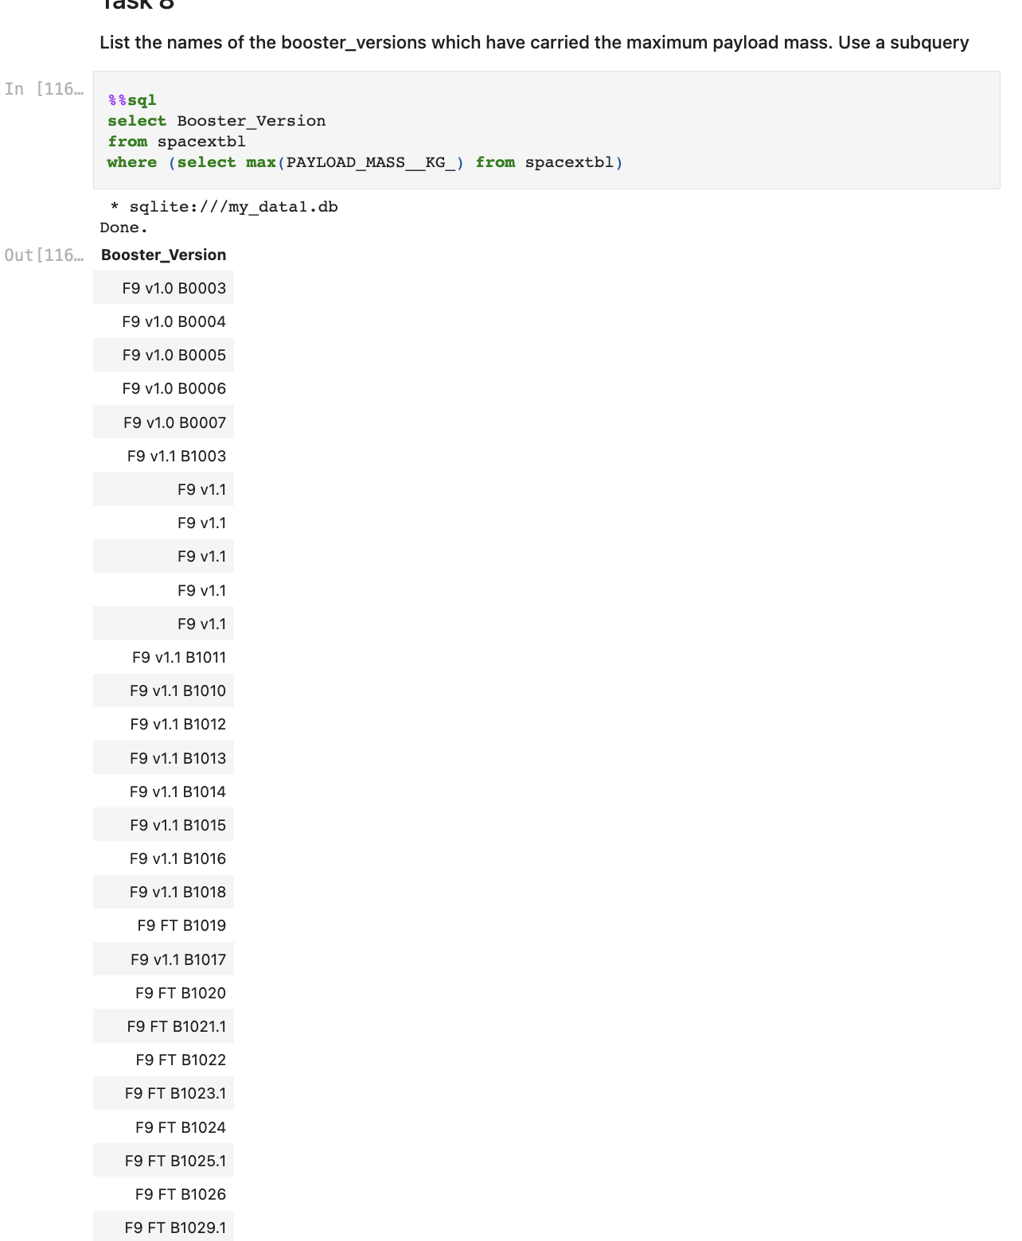
Boosters Carried Maximum Payload
List the names of the booster which have carried the maximum payload mass
Present your query result with a short explanation here

Slide 34
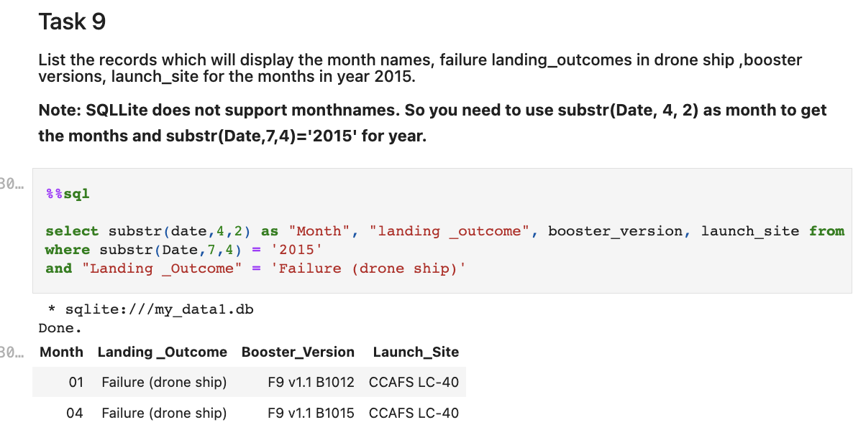
2015 Launch Records
List the failed landing_outcomes in drone ship, their booster versions, and launch site names for in year 2015
Present your query result with a short explanation here

Slide 35
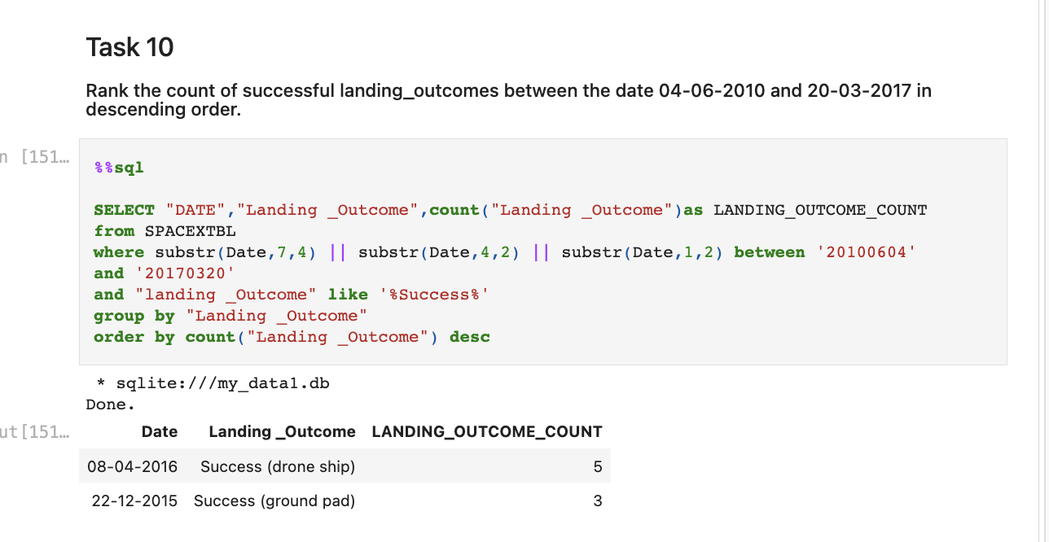
Rank Landing Outcomes Between 2010-06-04 and 2017-03-20
We can observe that there are a total of 8 successful landing outcomes between 2010 and 2017, where 5 boosters landed on drone ship and 3 on ground pad

Slide 36

Section 3

Slide 37
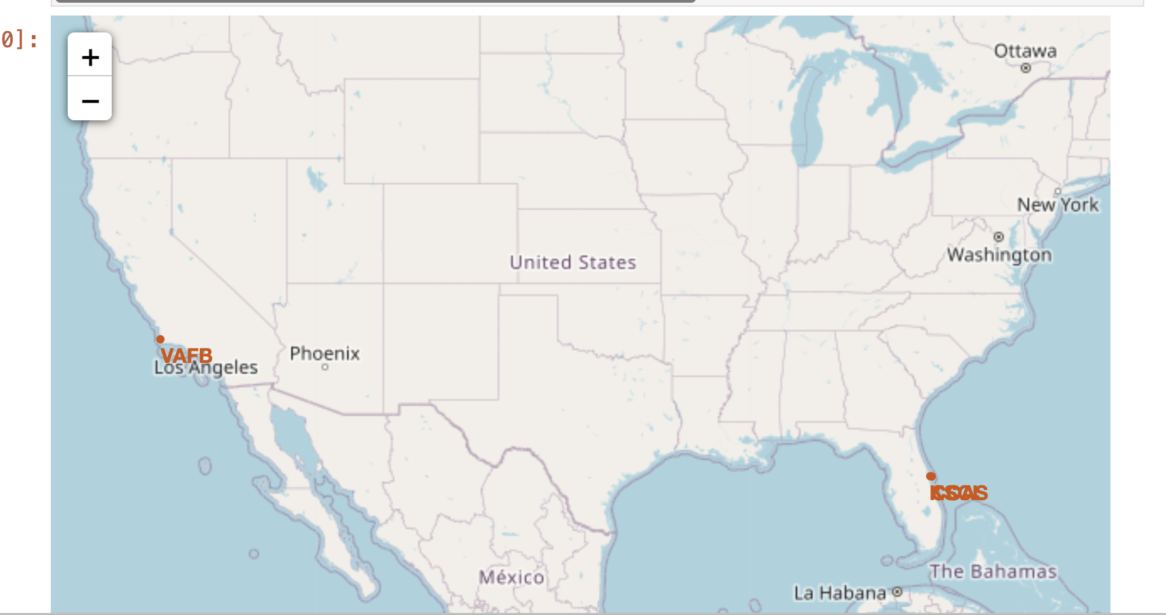
All Launch Sites Map
‘All launch sites’ location markers on a global map
The launch sites are above the equator line and closer to the coast
4 launch sites are marked in red
VAFB on the west coast
CCA, CCAS, KSLC on the southern coast

Slide 38
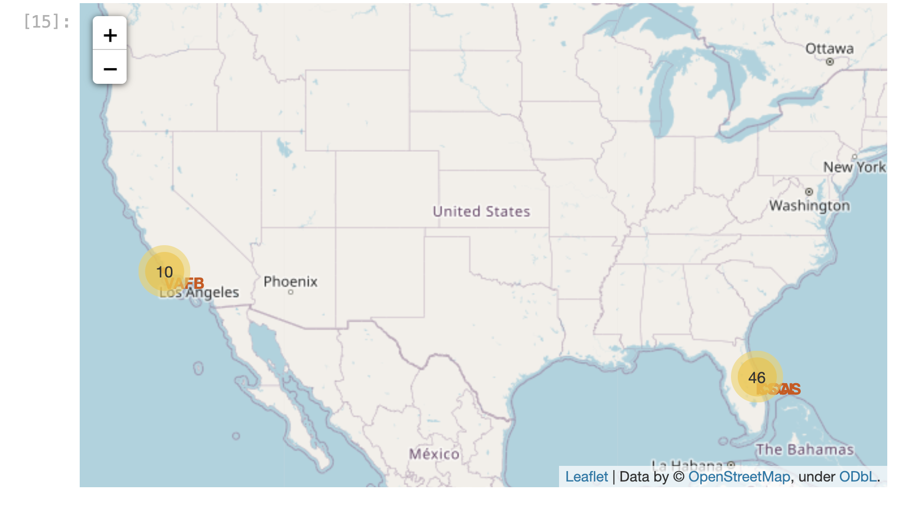
Launch Site Markers/Labels
We observer 10 launch outcomes from west coast launch site and 46 outcomes from the southern coast displayed as a cluster.
If we zoom in further, we can also see the launch outcomes

Slide 39
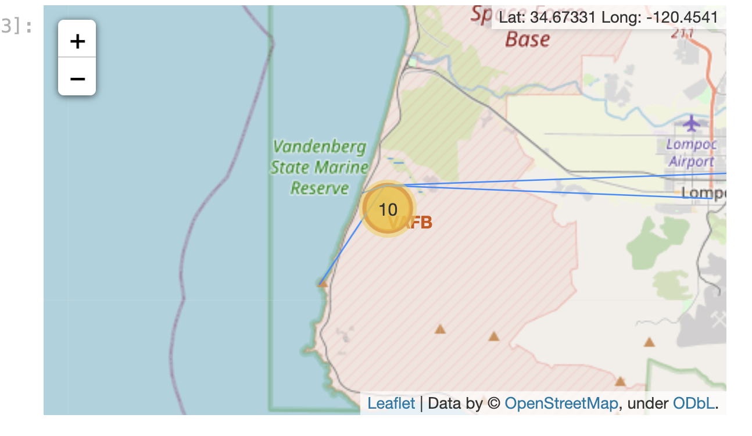
Launch Site Proximities
We observe that Launch sites are closest to the coast and then the railroads
The launch sites are little further from a city and a highway

Slide 40

Section 4

Slide 41
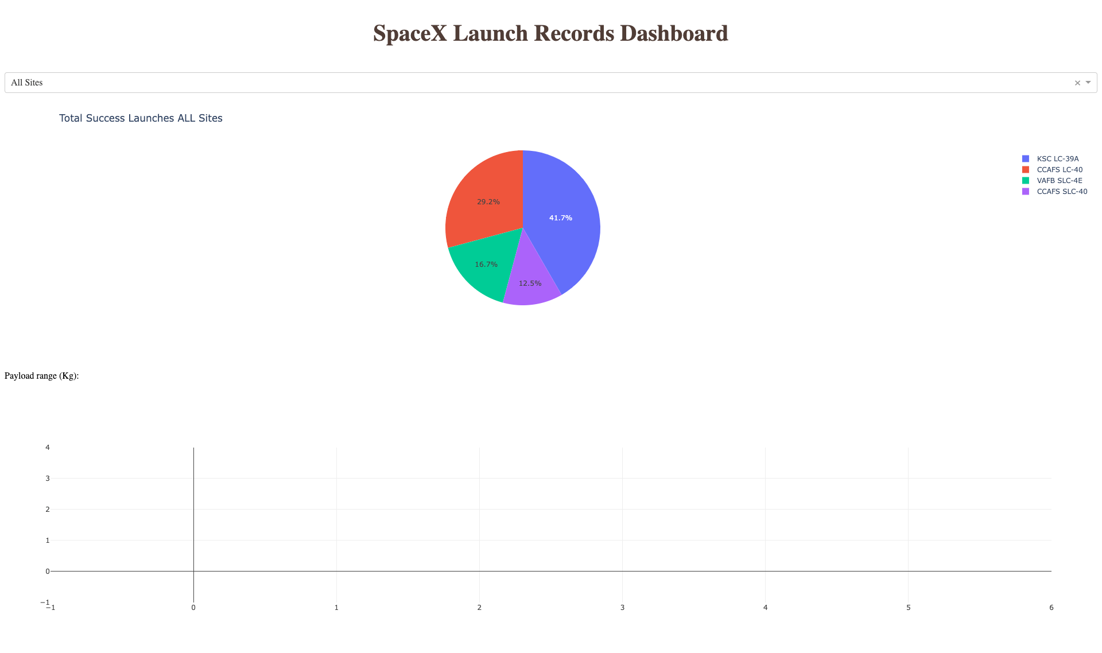
Launch Success for All sites
Pie chart displaying the success rate for all launch sites
We observe that KSC LC-39A has the maximum success rate and CCAFS SLC-40 has the least

Slide 42
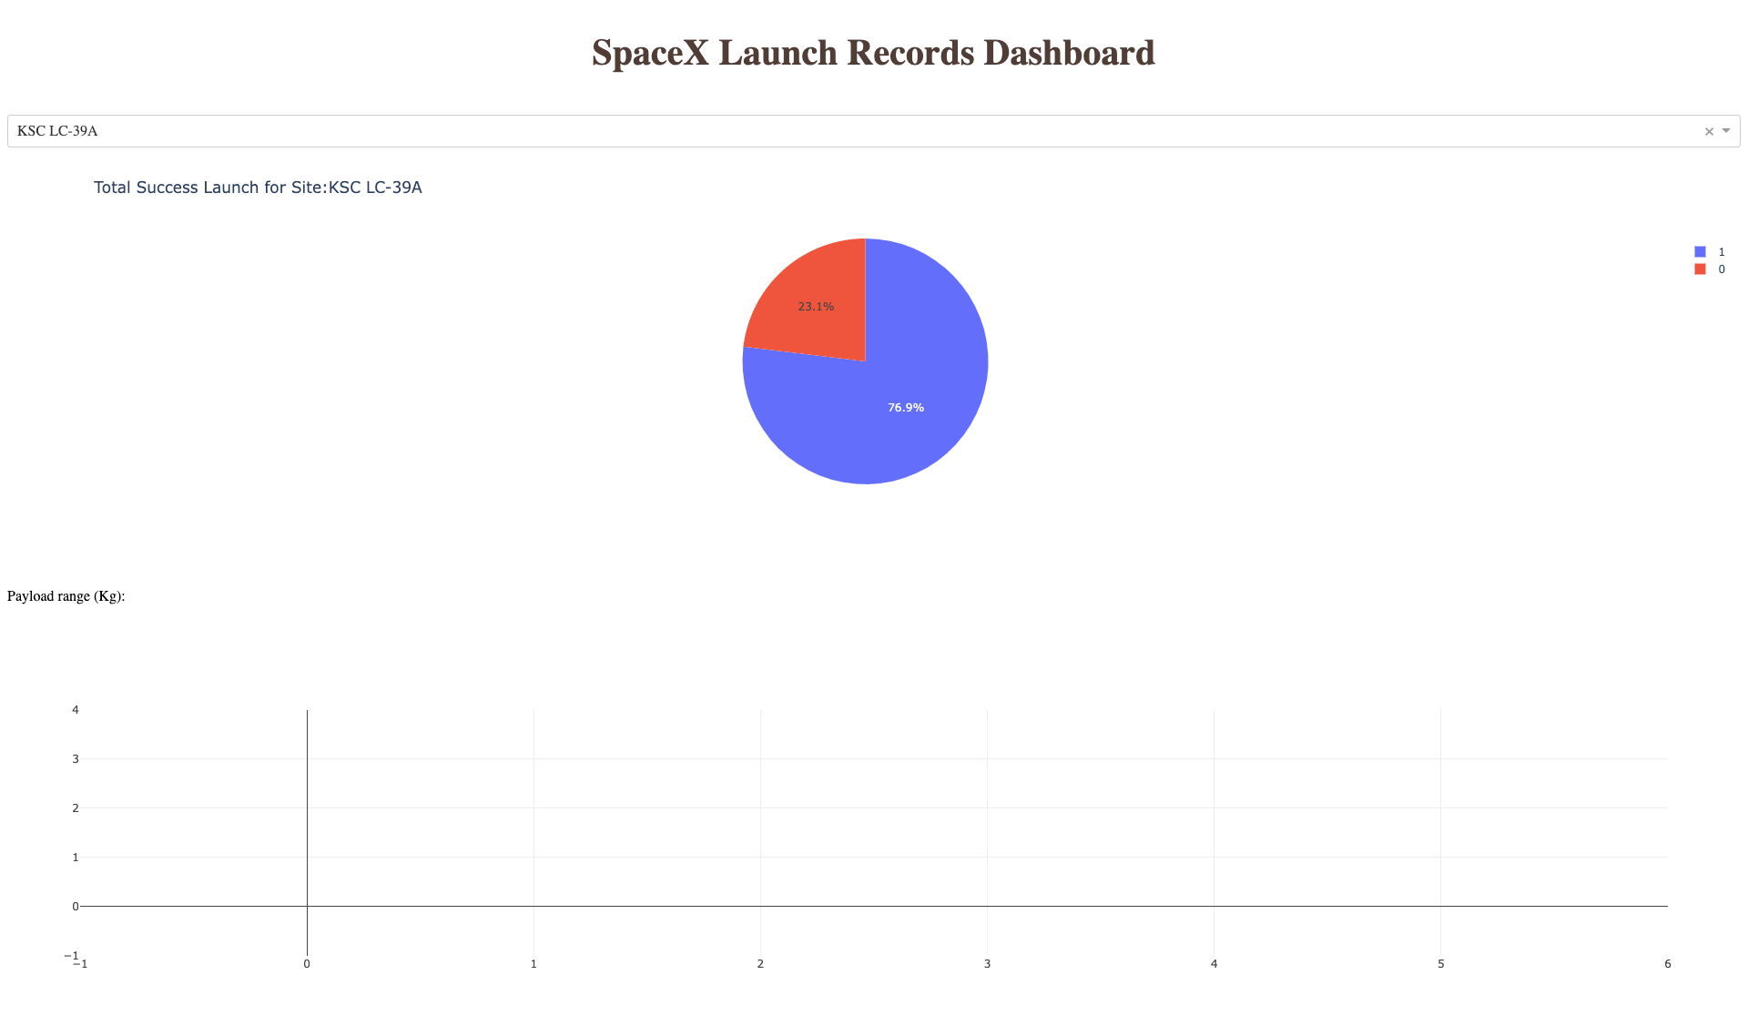
Launch Site with Highest Success
KSC LC-39A has the highest success

Slide 43
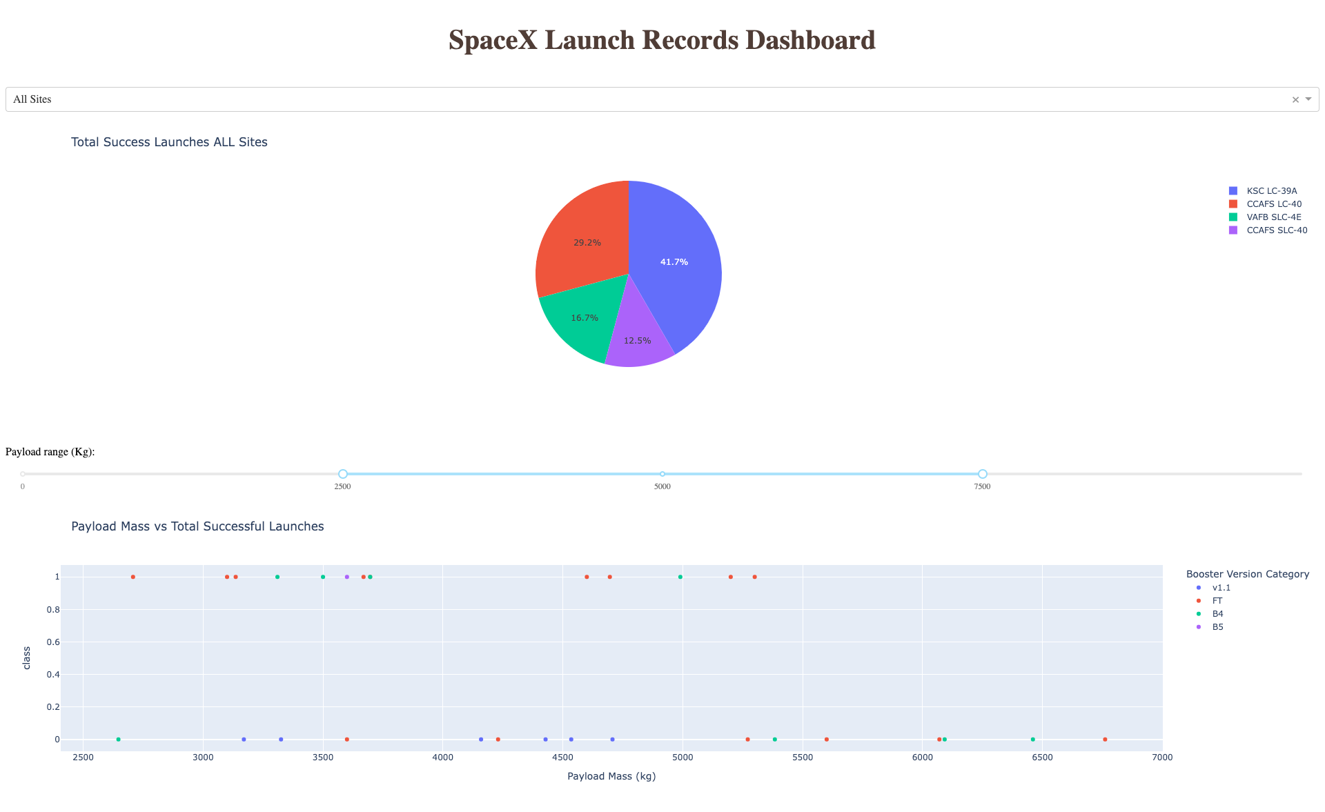
Payload Vs Launches
We observe the KSC LC-39A has a success rate of 41.7%
For the payload range of 2500 to 7500 Kgs, the boosters FT have the highest success rates and the booster v1.1 have the lowest

Slide 44

Section 5

Slide 45
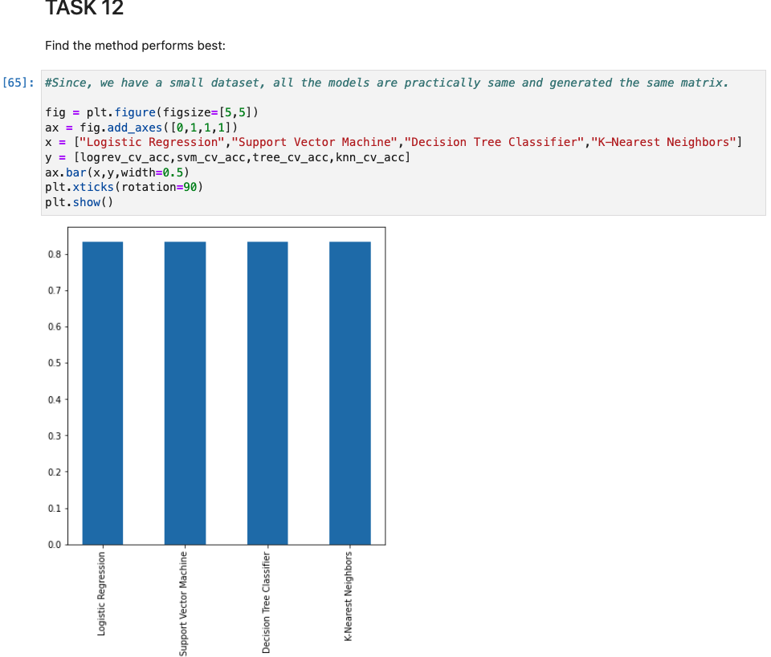
Classification Accuracy
Bar Chart for all models calculating accuracy
All models have same accuracy due to the small dataset

Slide 46
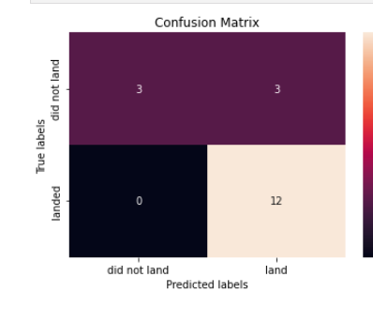
Confusion Matrix
Confusion matrix for landing outcomes displaying True positives, True negatives, False positives and False negatives
We notice that False positives (12) are more in this matrix

Slide 47
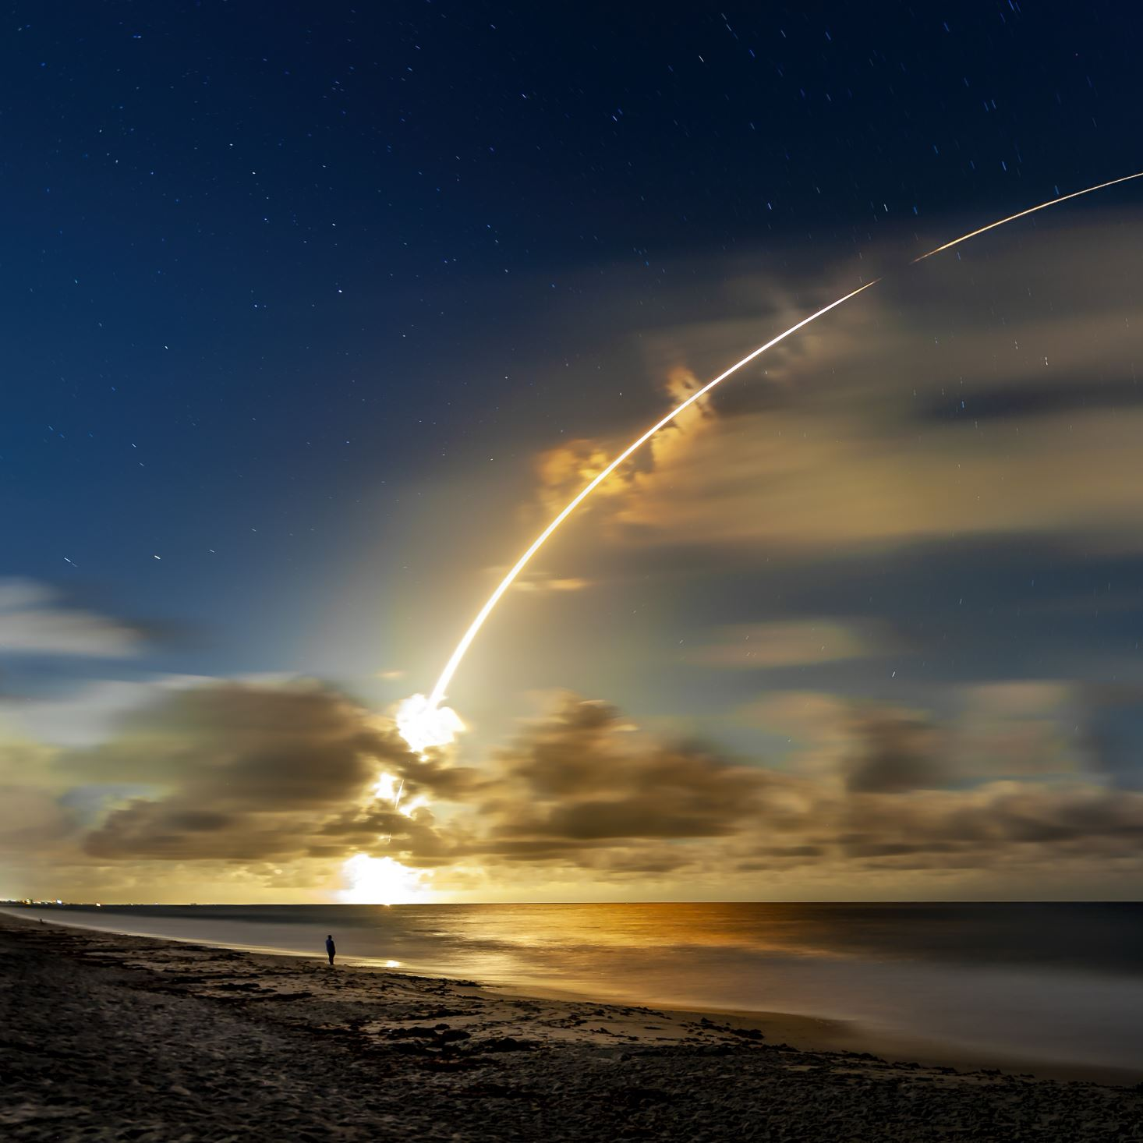
Conclusions
From our analysis we can conclude the following from the SpaceX Data:
Launch Sites are in closer proximities to coasts.
Successful Launches have kept increasing since 2013
A total of 8 successful landing outcomes between 2010 and 2017, where 5 boosters landed on drone ship and 3 on ground pad
Booster Version FT have more success rates for certain payloads and v1.1 have the least success rates
Launch Site KSC LC-39A has the highest success rate.
Machine learning models we trained have an accuracy of 83.3%, which can be considered a good model, all models performed the same due to the small dataset

Slide 48
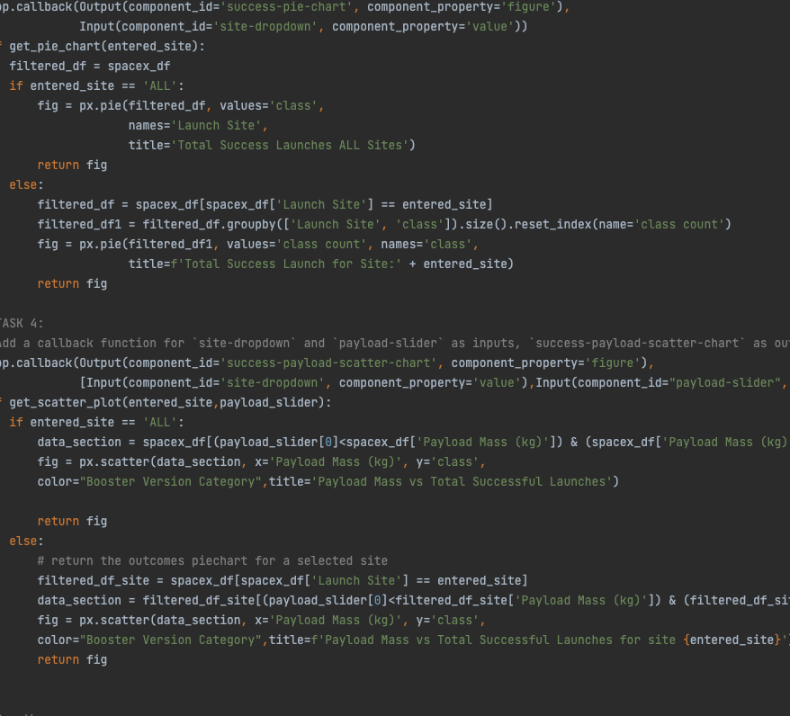
Appendix
Sample Dash Plotly Code for Callback functions
GitHub Repo Link for the complete capstone: https://github.com/bhavyasd/IBM-DataScience-Certificate/tree/main/Applied%20Data%20Science%20Capstone

Slide 49


